Slide 1
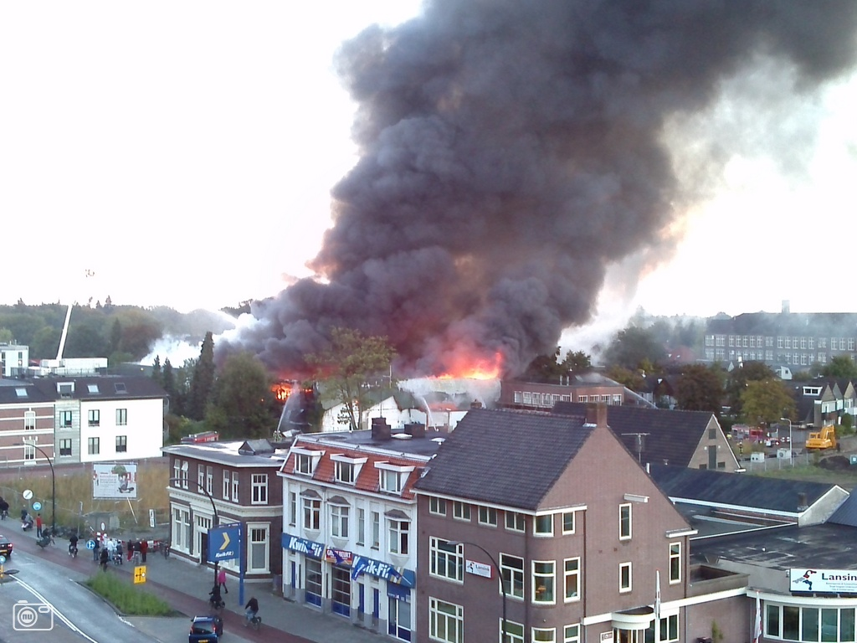
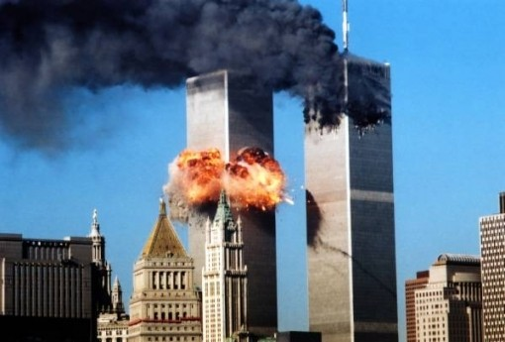
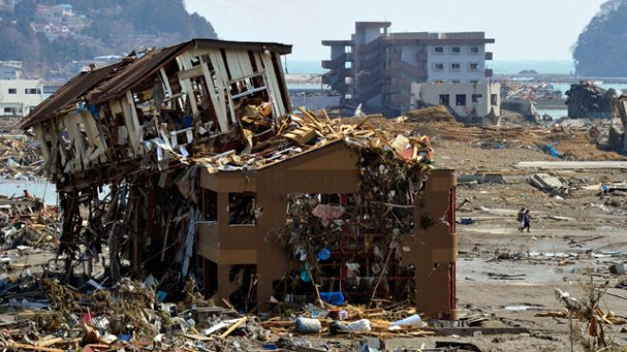
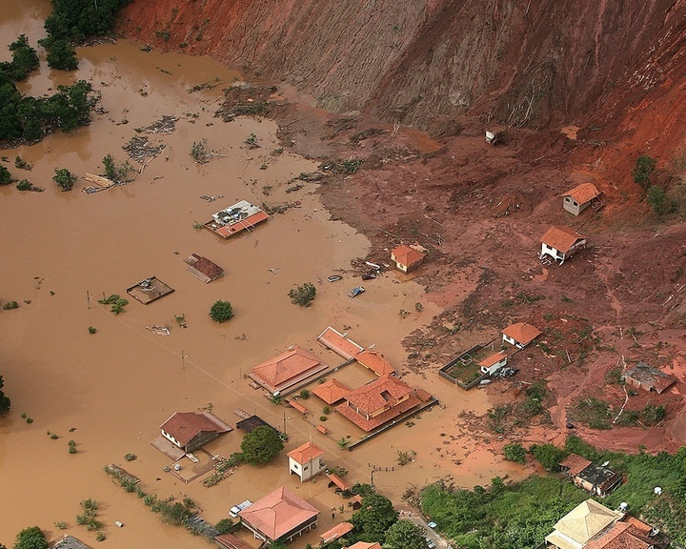
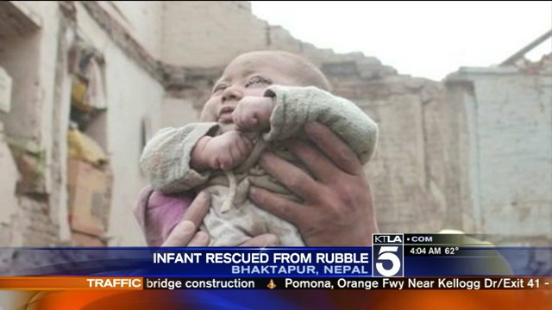
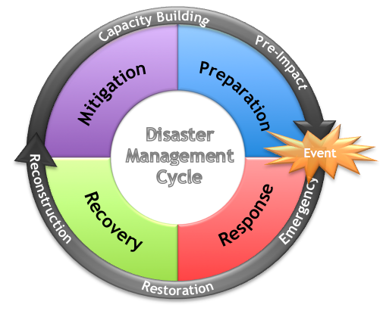




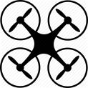












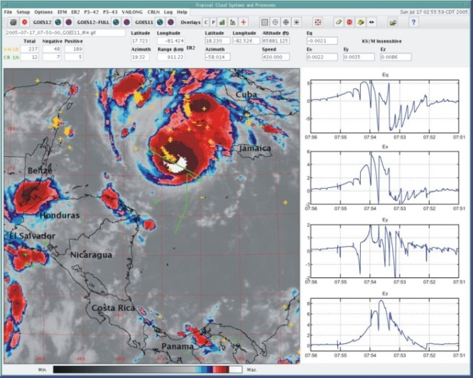
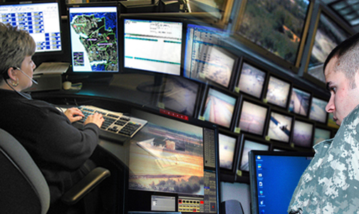
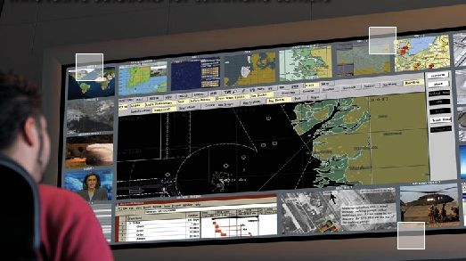
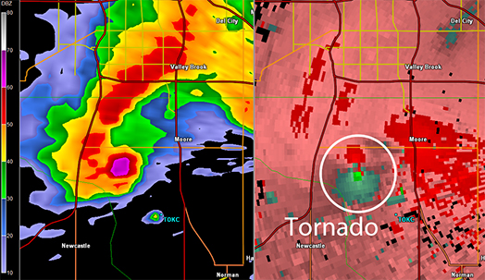






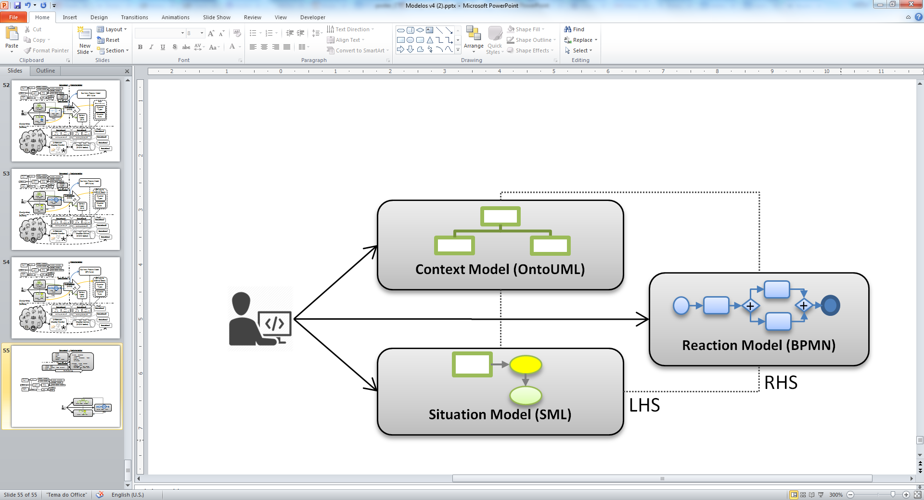
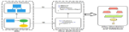

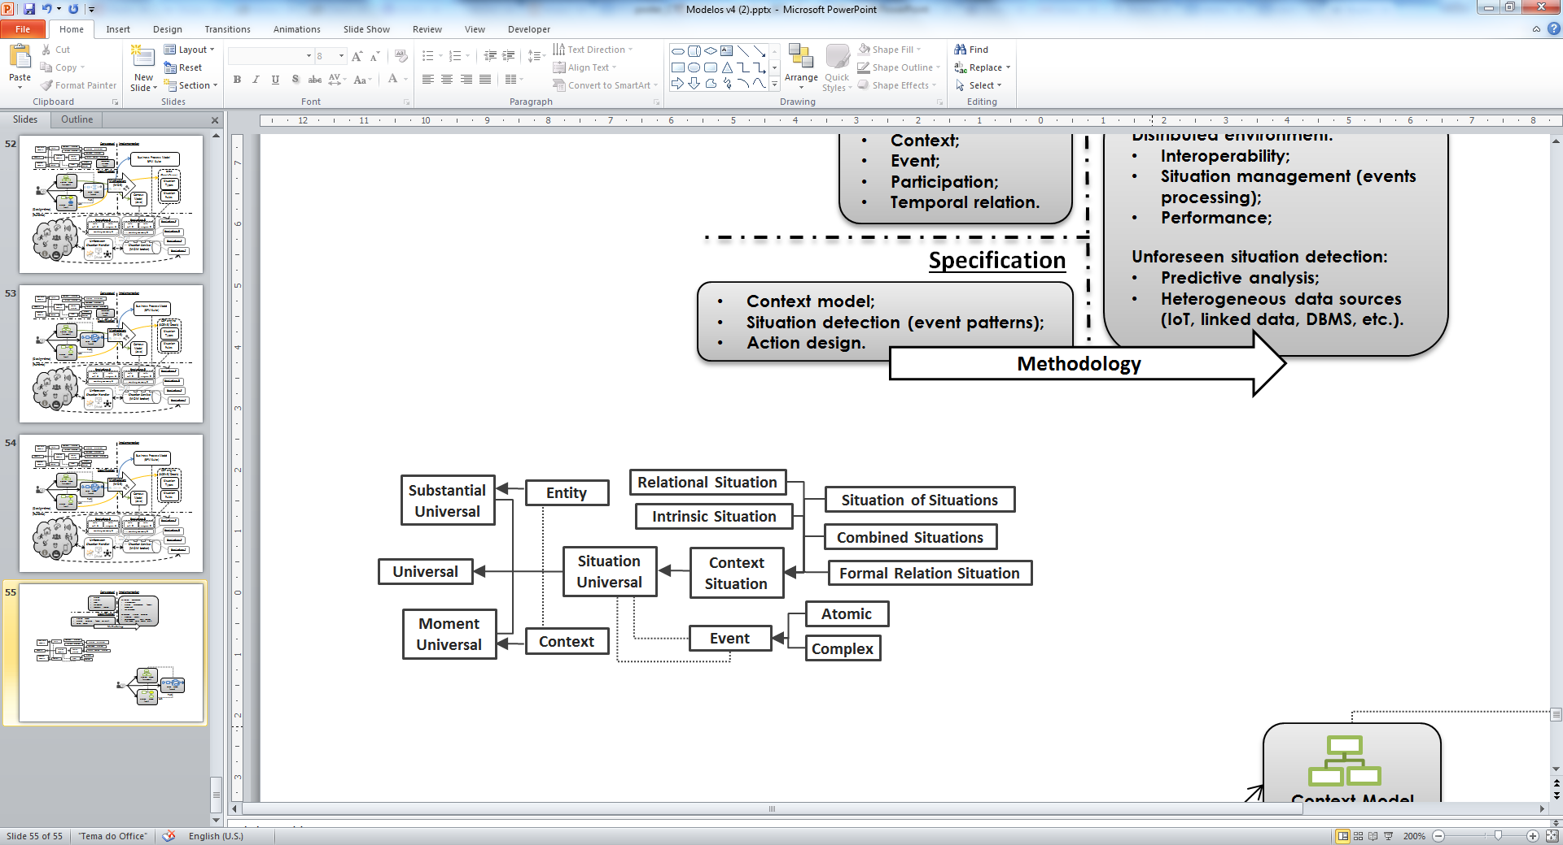
Supporting Disaster Management: A Framework for the Development of Situation Aware Applications
João Luiz Rebelo Moreira
Challenges
How to develop Situation Aware (SA) applications to support the disaster management process, considering:
Characterization of situations and response actions
Collaboration of situation’s information
Handling situations not specified at design-time
Intended Contributions
Social benefits: effective and efficient use of available resources aiming at less casualties and damage. Scientific goals of the framework:
Specification of situation and decision making
Architecture for distributed SA applications
Discovery mechanism of unforeseen situations
Fireworks disaster
Enschede, 2000
Terrorist attack
New York, 2001
Tsunami
Indonesia, 2004
Mudslides
Rio de Janeiro, 2011
Earthquake
Nepal, 2015
supported by SA applications:
SA application C
SA application D
SA application A
SA application B
Unforeseen Situation Discovery
(predictive analysis)
Rule Set C
Rule Engine C
Rule Set D
Rule Engine D
Working Memory C
Working Memory D
Shared WM
JMS
REST
SOAP
CORBA
FTP
HTTP
RMI
Situation Notification Service Bus
Runtime
Design-time
Methodology
(MDE)
Context Model (Java)
CEP engine
(SCENE/Drools)
Situation Types
Specification
Implementation
Situation Rules
Conceptual
Behavior Model (BPM Suite)
Service Compositions
Foundational Ontology (UFO)
Our Solution
A framework to guide the development and maintenance of interoperable SA applications
Preliminary results
Design of the architecture components and extension of a well-founded emergency ontology
Scientific Background
Temporal conceptualization with the Unified Foundational Ontology (UFO/OntoUML)
Model-driven engineering (MDE): from Situation Modeling Language (SML) to a rule-based system
Complex event processing (CEP) mechanism for distributed situation lifecycle management
Daily supervisors:
Luís Ferreira Pires ¹, Marten J. van Sinderen ¹, Patricia D. Costa ²
¹ Services, Cyber-security and Safety (SCS) group, University of Twente (UT), Netherlands
² Computer Science Department, Federal University of Espírito Santo (UFES), Brazil

